Slide 1
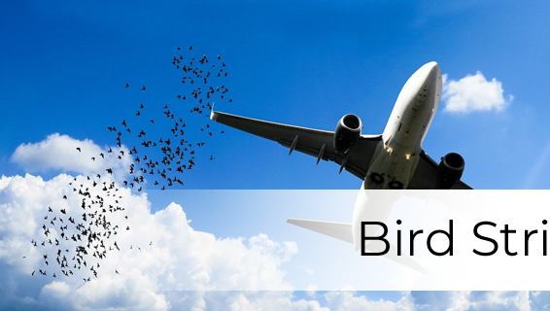
Bird Strike Analysis: Enhancing Aircraft Safety
A Comprehensive Study of Bird Strikes in the USA (2000-2011)
Presented By: Kaneez Masooma
Email: kaneezmasoomaofficial@gmail.com

Slide 2
Introduction
A bird strike is a collision between a bird and an aircraft, whether in flight or during take-off or landing. This term also includes other wildlife strikes involving bats or ground animals. Bird strikes are common and pose a significant threat to aircraft safety. Smaller aircraft can suffer substantial structural damage, and jet-engine aircraft are particularly vulnerable to thrust loss if birds are ingested into the engines. Such incidents have led to several fatal accidents. Bird strikes can occur during any flight phase but are most likely during take-off, initial climb, approach, and landing due to the higher concentration of birds at lower altitudes.

Slide 3
Project Overview
Objective: To analyze bird strike incidents in the USA from 2000 to 2011, identifying trends, impacts, and key insights to enhance aviation safety.
Data Description: Data contains 25558 entries & Includes information on 26 fields below:-
Record ID
Aircraft: Type
Airport: Name
Altitude bin
Aircraft: Make/Model
Wildlife: Number struck
Wildlife: Number Struck Actual
Effect: Impact to flight
FlightDate
Effect: Indicated Damage
Aircraft: Number of engines?
Aircraft: Airline/Operator
Origin State
When: Phase of flight
Conditions: Precipitation
Remains of wildlife collected?
Remains of wildlife sent to Smithsonian
Remarks
Wildlife: Size
Conditions: Sky
Wildlife: Species
Pilot warned of birds or wildlife?
Cost: Total $
Feet above ground
Number of people injured
Is Aircraft Large?

Slide 4
Key Questions
This project visually analyzes data on bird strikes in the USA from 2000 to 2011, covering various aspects:
Yearly Analysis & Bird Strikes in the US
Top 10 US Airlines encountering bird strikes
Top 50 Airports with the most bird strike incidents
Yearly Cost Incurred due to Bird Strikes
Altitude of aircraft at the time of strikes
Flight phase during bird strikes
Average Altitude of aircraft in different phases at the time of strike
Effect of Bird Strikes & Impact on Flight
Effect of Strike at Different Altitudes
Pilot Notification & Impact of Prior Warnings

Slide 5

Data Analysis

Slide 6
Total Cost Incurred
$14,22,90,445
Avg. Height at the Time of Strike
795 ft
Total Strikes
68,790
Worst Hit Phase of Flight
Approach
Key Bird Strike KPIs

Slide 7
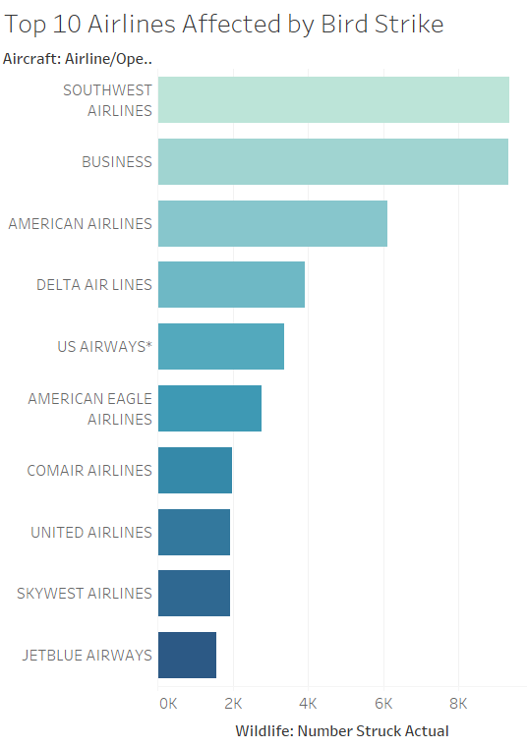
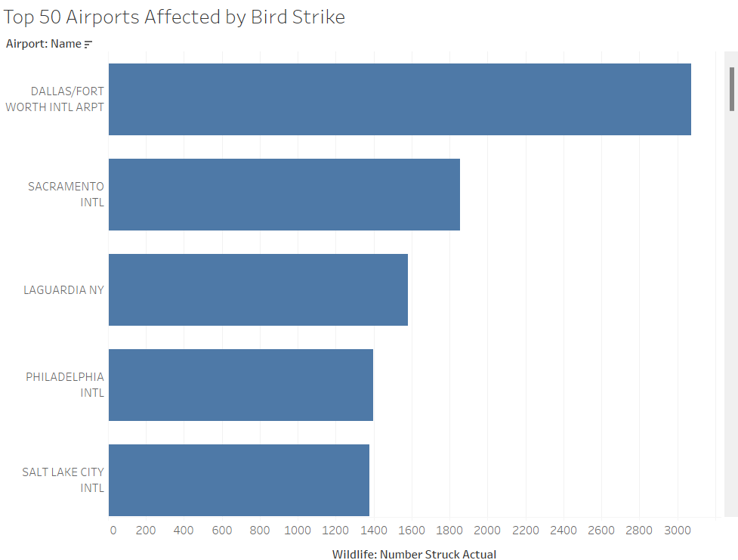
Top Airports and Airlines Affected
Top Airports: Dallas/Fort Worth International, Sacramento International, etc.
Top Airlines: Southwest Airlines, Business Airlines, etc.
Comment: Certain airports and airlines encounter more bird strikes, indicating hotspots for incidents.

Slide 8
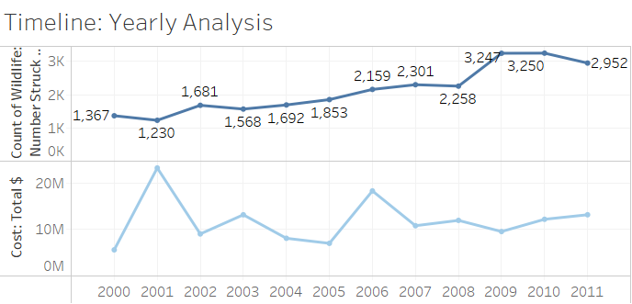
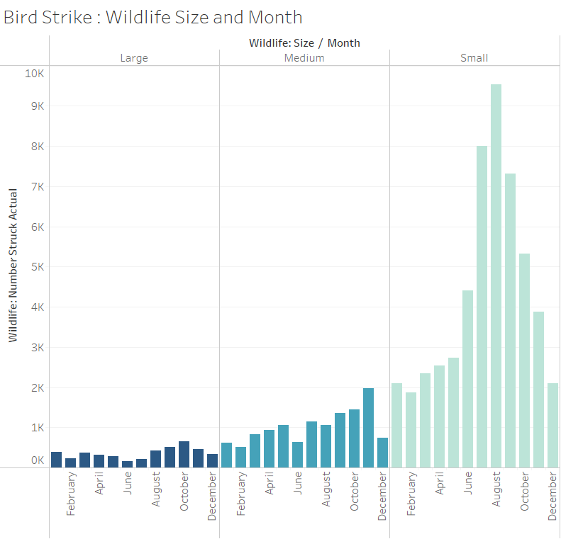
Timeline
The number of bird strikes has been increasing over the years.
In the last 3-4 years, costs have seen a steady upward trend.
Bird strikes are more frequent from June to November.
Comment: Small wildlife is more frequently involved in strikes.

Slide 9
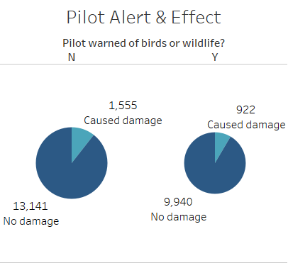
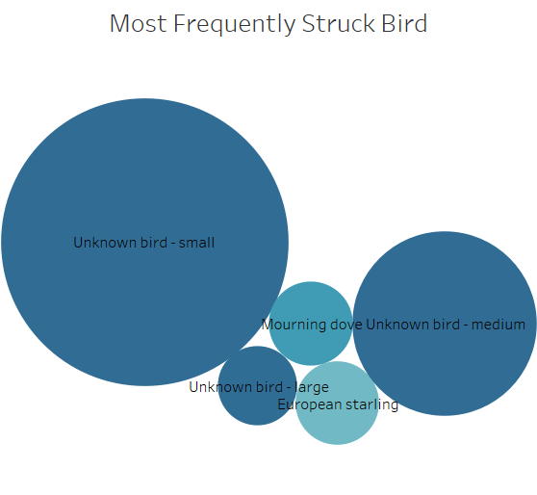
Pilot Notification Effect & Top Five Birds
Pilot alerts and pre-warnings significantly influence the extent of damage caused by bird strikes.
Comment: Most of the bird strikes have occurred because of because of ‘unknown small birds’.

Slide 10
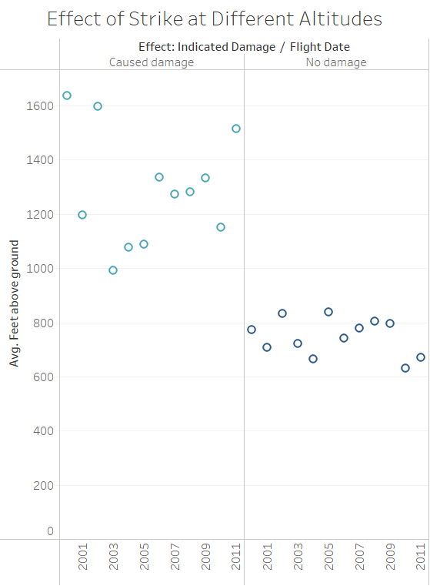
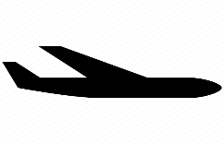
Effect of Strike at Different Altitudes
In every instance where no damage was reported, the aircraft was flying below 900 feet.
Conversely, all incidents of damage occurred at altitudes near or above 1000 feet.

Slide 11
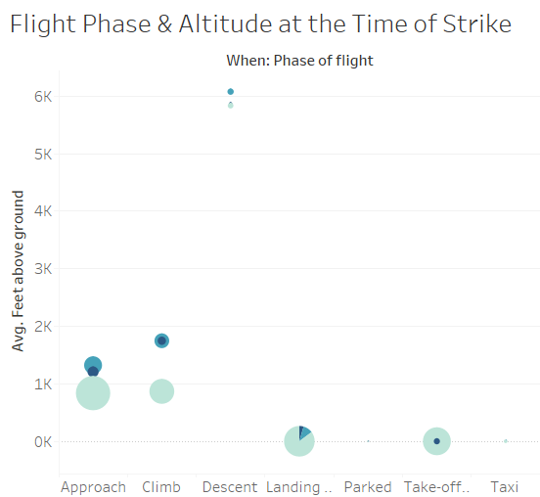

Flight Phase & Altitude
Majority of bird strike occur at Approach, Climb & Landing phases.
The highest altitude for bird strikes is seen during the descent phase, peaking around 6000 feet.
Bird strikes at ground level, such as during taxiing, parked, are rare and usually involve smaller birds.
At take-off, large birds are also involved.

Slide 12
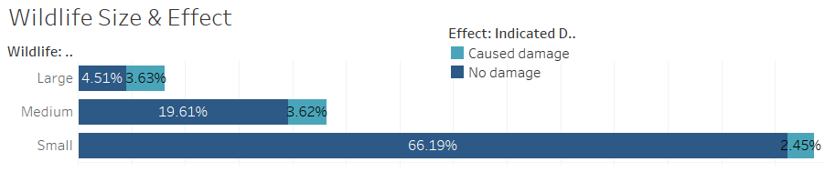
Wildlife Size & Effect
Comment: Although less frequent, strikes involving large and medium birds result in more significant damage.

Slide 13
Recommendations and Conclusion
The analysis of bird strike data from 2000-2011 reveals critical insights into the factors contributing to these incidents. By understanding the patterns and impact of bird strikes, we can implement effective measures to mitigate risks.
Continuous monitoring, advanced detection systems, habitat management, and enhanced pilot training are essential to reducing the frequency and severity of bird strikes.
Collaborative efforts between aviation authorities, wildlife experts, and policymakers will ensure the safety and reliability of air travel, protecting both human lives and wildlife.
Together, we can create a safer aviation environment and minimize the threats posed by bird strikes.

Slide 14
Thank You!

